Slide 1

Localization and Autonomous Navigation of a Mobile Robot: Robomuse 5.0
Shashank Dammalapati (2017ME10572)
Pavan (2017ME10583)
Chaitanya Ram (2017ME10576)
Supervised by
Prof. Subir Kumar Saha
DEPARTMENT OF MECHANICAL ENGINEERING
INDIAN INSTITUTE OF TECHNOLOGY, DELHI
FEB 2021
(Project code: D-3)

Slide 2
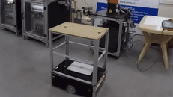
Introduction
Mobile robotics is the field of robotics concerned with robots that can move around in an environment
Awareness of its environment is crucial for attaining Autonomy
The major research areas in this field are Navigation, motion planning, Context driven exploration, Simultaneous Localization, and Mapping (SLAM).
We have various sensors and SLAM techniques for creating awareness to the robot
Collaborative Mobile Robots-Designed to work with humans
(Taken from Peer Robotics Company)

Slide 3
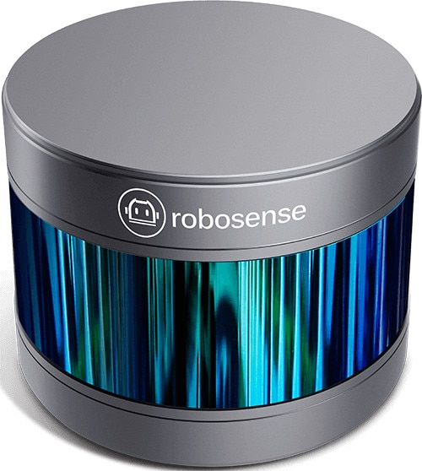
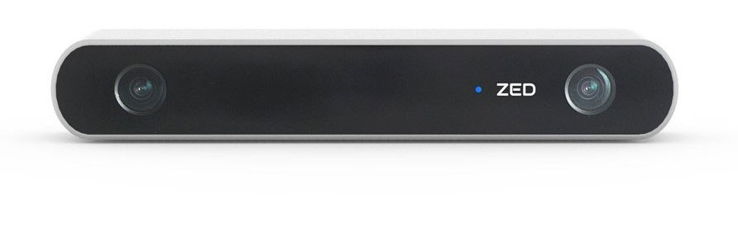
LITERATURE SURVEY Sensors
Both Vision and Lidar based sensors are absolute sensors unlike sensors like IMUs which give only Relative measurements
Vision Sensors are cheaper than LIDAR sensors
Lidar sensors provide precise scan data than Vision sensors
We are using LIDAR based sensors for better autonomous navigation.

Slide 4
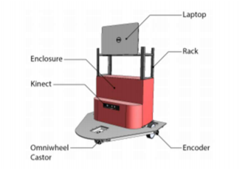
LITERATURE SURVEY
Robomuse
IIT Delhi has its own robot series called RoboMuse.
The last Robomuse 4.0 used the Kinect(Vision) Sensor to map and explore its surroundings, as well as Aruco Markers for odometry error correction that builds over time.
Robomuse 5.0 is to build with Lidar based SLAM technique such as Gmapping which uses scan matching as for the robots odometry. It has two lidars for measuring depth.
In contrast to the Kinect sensor used in Robomuse 4.0, which produces unreliable pseudo-laser scan results, Lidar sensors provide precise scan data.

Slide 5
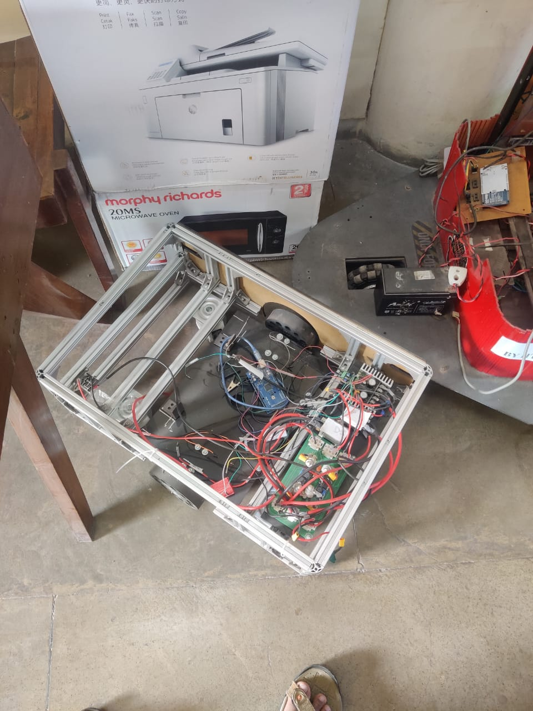
Project Objectives
Solving the automation in the textile industries where barrels containing fabric materials are transported from one place to the other.
At the beginning of the project, RoboMuse 5.0 frame is available. So, we will utilize the structure and integrate hardware/software stack to make it autonomous. We will test the system in a real environment.
We can divide the project into 3 parts - Mechanical, Electrical and installing Software stack, Testing in Real World.
Installing the algorithm studied in the simulation. Redesign the Robomuse 5.0 and build it completely.

Slide 6
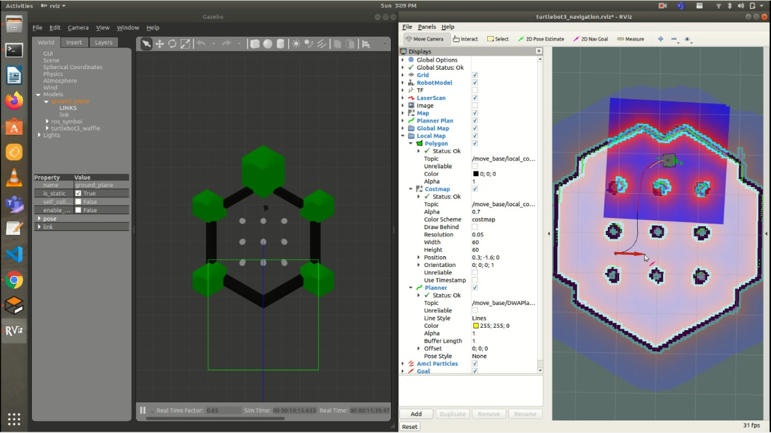
Methodology
Simulating TurtleBot robot on Gazebo
Testing Mapping and Navigation Stack on Turtlebot3 robot using ROS packages
We use GMapping packages for implementing SLAM, and AMCL package for implementing Navigation
Designing the Electric Circuit and required PCB
Building the complete RoboMuse 5.0
Testing RoboMuse 5.0 for Autonomous Navigation in real environment.

Slide 7
Gantt Chart
Current Situation
TASK | Week 1-2 | Week 3-4 | Week 5-6 | Week 7-8 | Week 9-10 | Week 11-12 | Week 13-14
Literature Review about Lidar-SLAM & Visual Inertial- SLAM
Learning ROS & Simulating Turtlebot 3 Robot
Implementing Lidar based SLAM & Navigation in Gazebo & Rviz
Started Working on RoboMuse 5.0 PCB Design | AGV Control System
Implement SLAM & Navigation in Robomuse 5.0
Conducting Navigation in Real Environment
Report Making

Slide 8
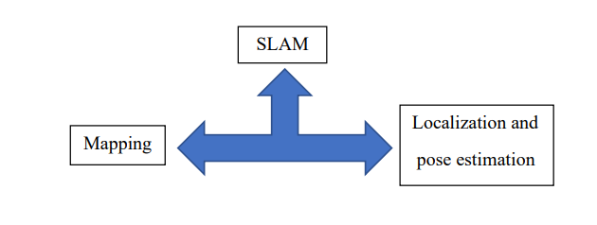
SLAM - THEORY
ROS SLAM GMapping:
This package contains GMapping, from OpenSlam, and a ROS wrapper.
The gmapping package provides laser-based SLAM, as a ROS node called slam_gmapping.
Adaptive Monte-Carlo Localization (AMCL):
AMCL, which is a particle filter based is used to localize the mobile robot in an indoor environment.
Specifically, it refers to estimation of the position and orientation of a robot within the previously generated map.

Slide 9
Experimental Setup
Simulation in ROS:
Spawned TurtleBot3 in Gazebo as a Node
Controlled Turtlebot3 using Teleop Node
Implement GMapping Stack using TurtleBot3 | moved robot using teleop Node
Saving the generated GridMap of the Environment
Loading the GridMap and implementing Navigation stack on TurtleBot
Implemention on the RoboMuse 5.0
Testing and Optimizing SLAM and Navigation stack parameters specific to our testing environment

Slide 10
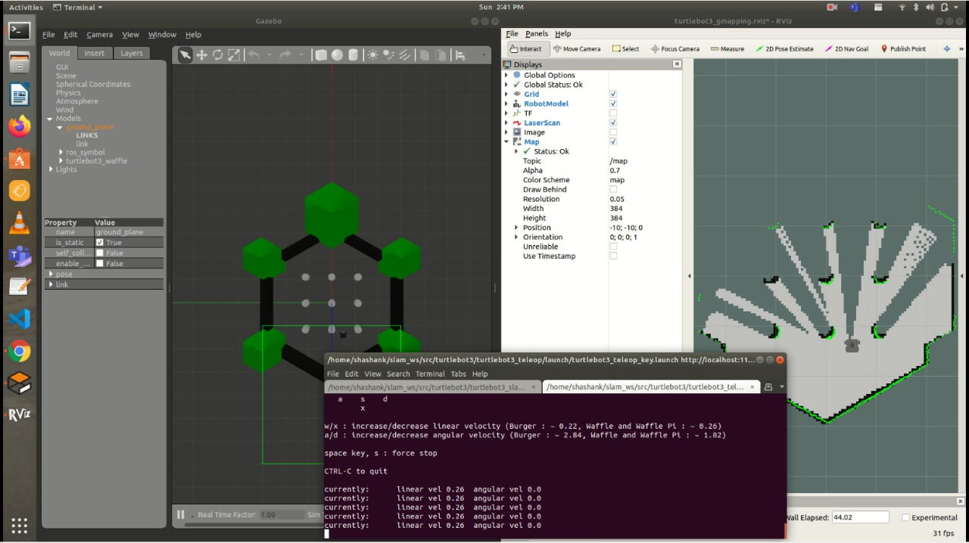
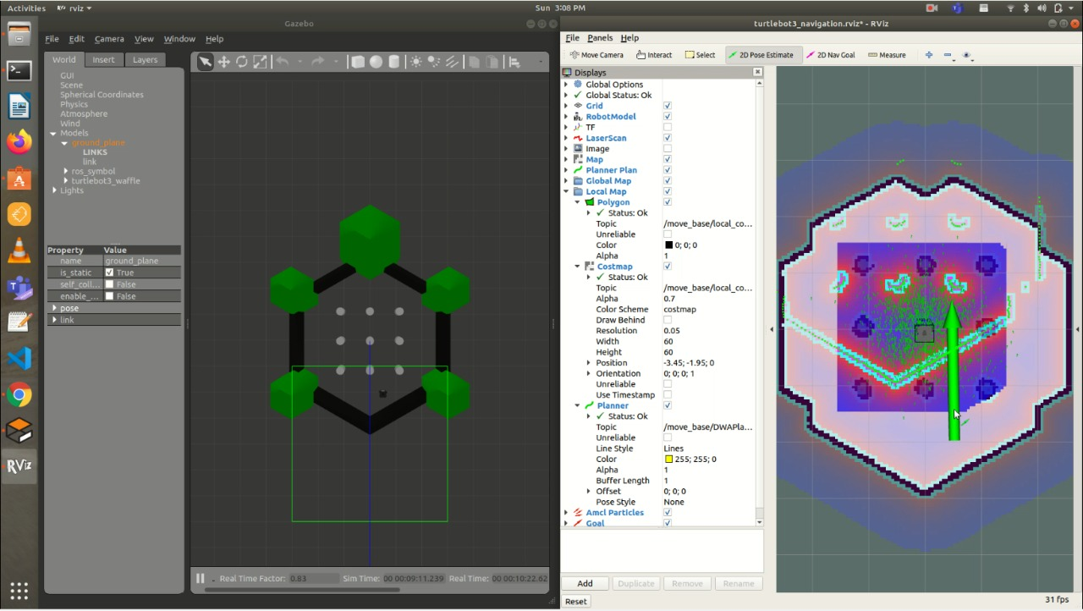
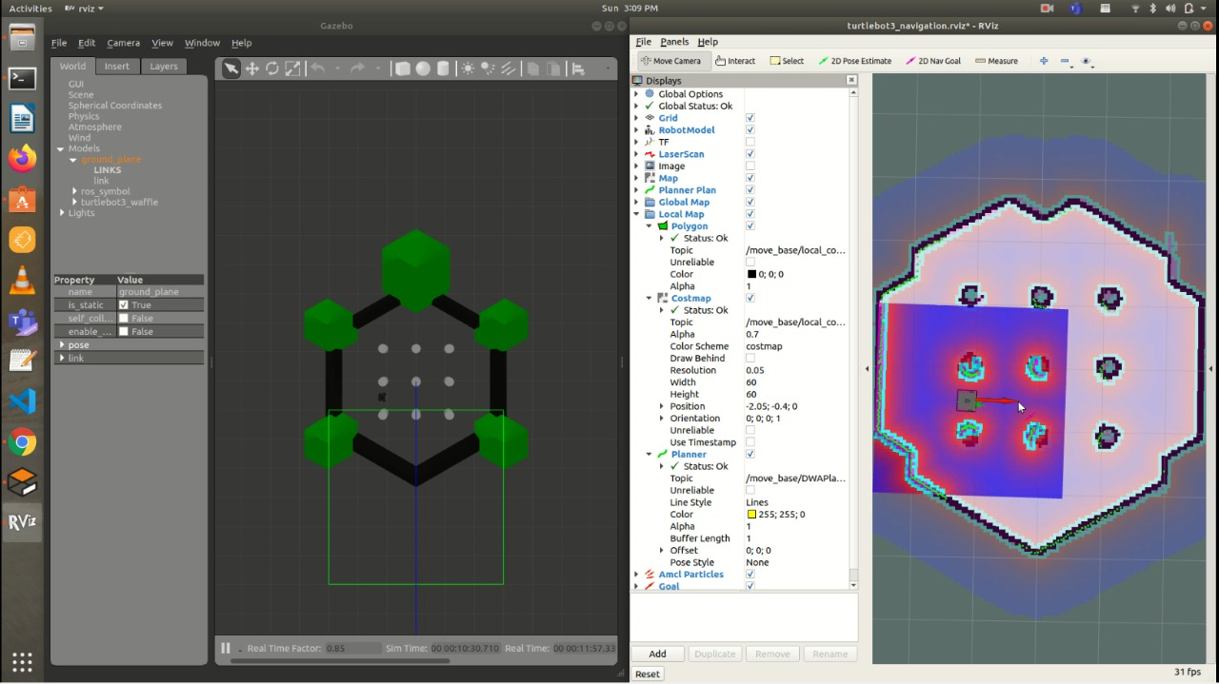
RESULT
Launched Gazebo simulator node | GMapping Node
Initializing the robots current location in RViz (Navigation stack Node)
On the left we can see the global path planning and on the right we can see that the robot reached its goal
Current task ahead is to build the robot and run it using ROS.

Slide 11
Conclusion
Literature Review
Learning ROS & Simulating Turtlebot 3 Robot
Implementing Lidar based SLAM & Navigation in Gazebo & Rviz
Started Working on RoboMuse 5.0 PCB Design | AGV Control System
Implement SLAM & Navigation in Robomuse 5.0
Conducting Navigation in Real Environment
Report Making

Slide 12


Thank You

